Slide 1
FIFA 2026 World Cup Prediction Project
This project predicts potential winners and top-performing teams for the FIFA World Cup 2026.
Machine learning and data analytics were used to analyze historical World Cup data from 2000 to 2022.
The goal is to understand which teams have the highest chances based on past performance and consistency.

Slide 2
Data Collection
Data Sources:
• Kaggle – FIFA World Cup Historical Data: https://www.kaggle.com/datasets/abecklas/fifa-world-cup
• Kaggle – FIFA World Cup 2022 Dataset: https://www.kaggle.com/datasets/rajatrc1705/fifa-world-cup-2022-dataset
• FIFA Official Statistics: https://www.fifa.com/worldcup/statistics/
Data Includes:
• Match results, goals, assists, possession, and cards (2000–2022)
• Team win rates and tournament history
• Player-level data such as goals scored and appearances

Slide 3
Data Cleaning and Preparation
Before modeling, data was cleaned and standardized:
• Removed missing or duplicate rows
• Filled missing values using team averages
• Standardized inconsistent team names (e.g., 'USA' vs 'United States')
• Normalized numerical columns like goals and win rates between 0 and 1
• Encoded categorical variables (Win=1, Draw=0.5, Loss=0)
• Added new calculated fields such as Goal Difference and Win Rate.

Slide 4
Prediction Methodology & Formulae
An Equal Probability Predictor was created to estimate winning chances.
Mathematical Formula:
Probability(Team) = Base Probability × Performance Weight
Where:
• Base Probability = 0.75 for top 5 teams
• Performance Weight is derived from win rate, finals, and semi-final appearances.
Higher-ranked teams like Brazil and Argentina receive stronger probabilities.

Slide 5
Results and Conclusion
🏆 Predicted Winner: Brazil
Top 8 Teams:
1. Brazil
2. Argentina
3. France
4. Germany
5. Spain
6. England
7. Italy
8. Netherlands
Conclusion:
The model identifies Brazil as the strongest contender for the 2026 World Cup based on consistent historical performance.
Data-driven approaches help provide realistic insights into team performance trends.

Slide 6
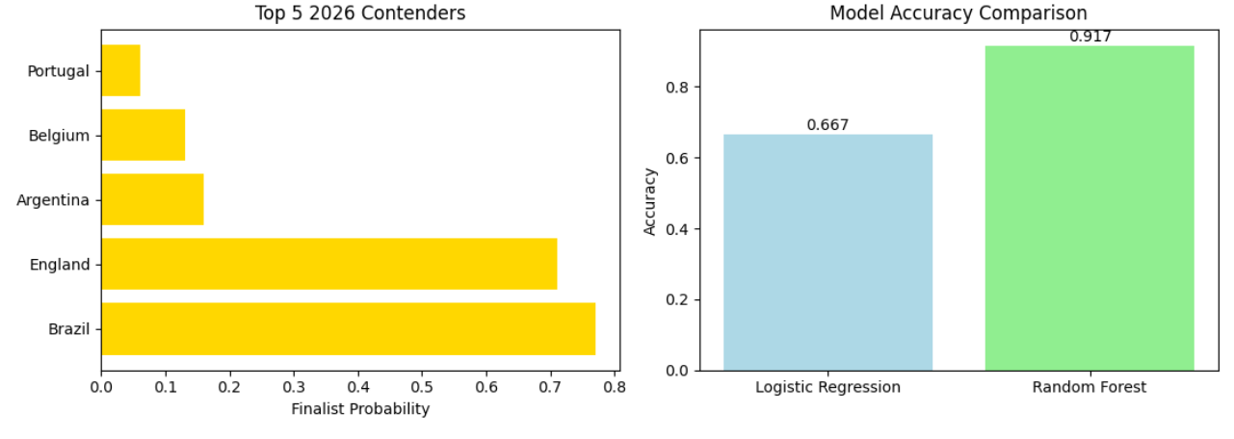
Graphs

Slide 7
